Slide 1
Sessions.
Registration and Authentication.
Oleksii Zaitsev
16.02.2012

Slide 2
Agenda
Sessions
Registration and Authentication

Slide 3
Sessions
Your application has a session for each user in which you can store small amounts of data that will be persisted between requests. The session is only available in the controller and the view and can use one of a number of different storage mechanisms

Slide 4
Sessions
Storage mechanisms
ActionDispatch::Session::CookieStore – Stores everything on the client.
ActiveRecord::SessionStore – Stores the data in a database using Active Record.
ActionDispatch::Session::CacheStore – Stores the data in the Rails cache.
ActionDispatch::Session::MemCacheStore – Stores the data in a memcached cluster

Slide 5
Sessions
The CookieStore can store around 4kB of data
avoid storing complex objects (anything other than basic Ruby objects)

Slide 6
Sessions
If you need a different session storage mechanism, you can change it in
config/initializers/session_store.rb

Slide 7
Sessions
Rails sets up a session key (the name of the cookie) when signing the session data. These can also be changed in
config/initializers/session_store.rb
YourApp::Application.config.session_store
:cookie_store,
:key => '_your_app_session'

Slide 8
Sessions
Secret key used for signing the session data. This can be changed in
config/initializers/secret_token.rb

Slide 9
Sessions
In your controller you can access the session through the session instance method.
Session values are stored using key/value pairs like a hash
To store something in the session, just assign it to the key like a hash

Slide 10
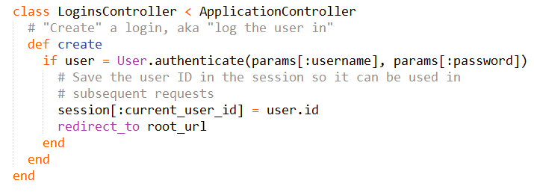
Sessions

Slide 11
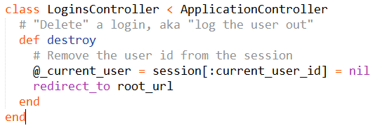
Sessions
To remove something from the session, assign that key to be nil:

Slide 12
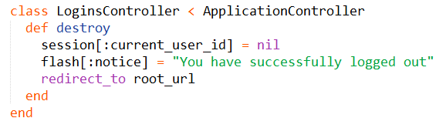
Sessions
The Flash
The flash is a special part of the session which is cleared with each request

Slide 13
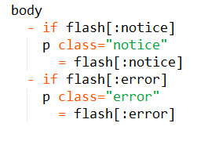
Sessions

Slide 14

HTTP Authentications
HTTP Basic Authentication
You can create namespaced controllers that inherit from AdminController

Slide 15
HTTP Authentications
Rails 3.1 gives us secure_password
DEMO TIME

Slide 16
HTTP Authentications
Instruments for authentication
Devise
Authlogic
OmniAuth
Restful-authentication
And many other

Slide 17
Links
http://railscasts.com/?tag_id=25
http://guides.rubyonrails.org/action_controller_overview.html#session
http://guides.rubyonrails.org/action_controller_overview.html#http-authentications

Slide 18
Contacts
Europe Headquarters
52 V. Velykoho Str.
Lviv 79053, Ukraine
Tel: +380-32-240-9090 Fax: +380-32-240-9080
E-mail: info@softserveinc.com
Website: www.softserveinc.com
US Headquarters
12800 University Drive, Suite 250 Fort Myers, FL 33907, USA
Tel: 239-690-3111 Fax: 239-690-3116
Thank You!
Copyright © 2010 SoftServe, Inc.

